Slide 1


Reinforcement Learning
Ch. 8: Planning and Learning with Tabular Methods
Richard S. Sutton
MIT Press

Slide 2
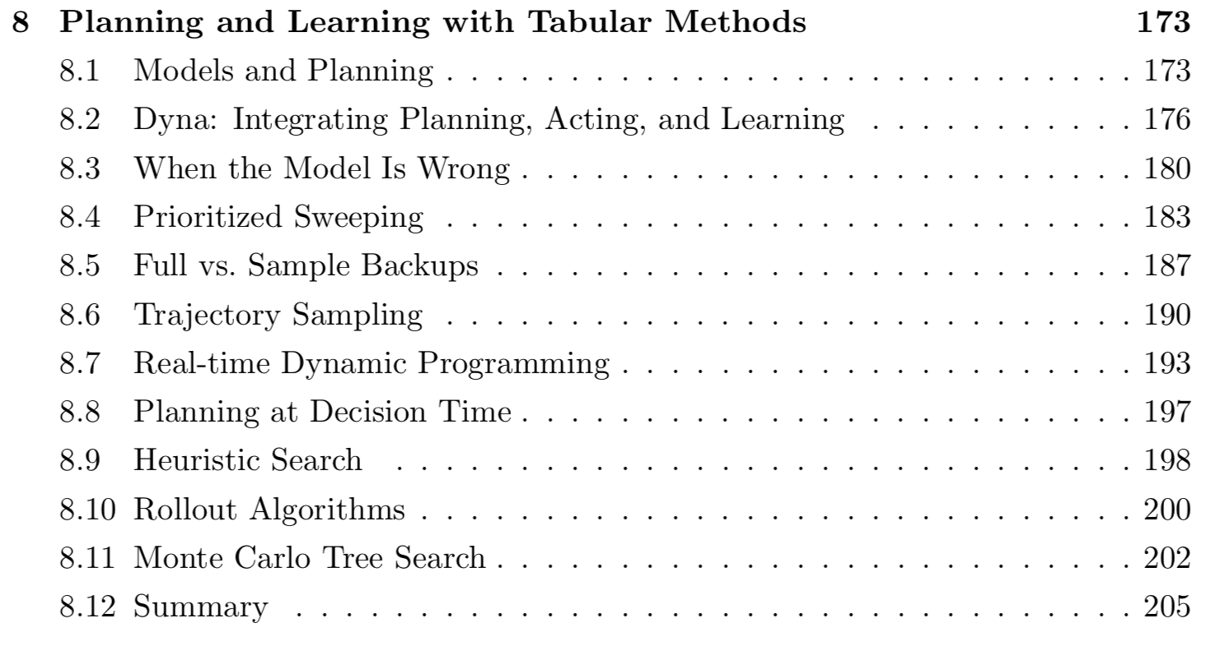
Ch. 8 Planning and Learning with Tabular Methods

Slide 3
Ch. 8 Planning and Learning with Tabular Methods
In this chapter,
Develop a unified view of ‘Planning’ (model-based. Ex. DP, HE) and ‘Learning’ (model-free. Ex. MC, TD).
The heart of both kinds of methods is the computation of value functions.
All the methods are based on looking ahead to future events,
Computing a backed-up value
Using it as an update target for an approximate value function.

Slide 4
8.1 Models and Planning
모델이란:
Anything that an agent can use to predict how env. will respond to its action
Given a state and an action, a model produces a prediction of the resultant next state and next reward.
- If model is stochastic, several possible state and reward. -
Distribution models: produce a description of all possibilities and their probabilities.
Sample models: produce just one of the possibilities, sampled according to the probabilities.
Model can be used to mimic or simulate experience.

Slide 5
8.1 Models and Planning
Planning
Takes a model as input and produces or improves a policy for interacting with the modeled environment
Two basic ideas of planning:
Computing value functions as a key intermediate step toward improving the policy
Compute their value functions by backup operations applied to simulated experience
Various planning methods fit this structure, with individual methods differing only in the kinds of updates they do, the order in which they do them, and in how long the backed-up information is retained.
Planning
Model
Policy

Slide 6
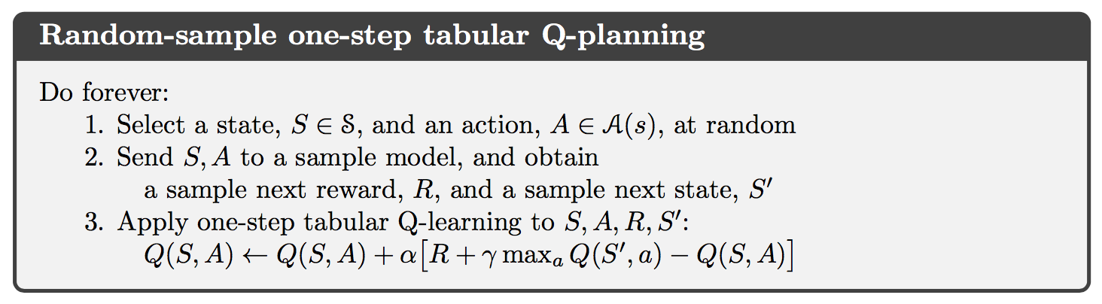
8.1 Models and Planning
The heart of both learning and planning methods is the estimation of value functions by backup operations.
Planning: uses simulated experience generated by a model.
Learning: uses real experience generated by the environment.
It means that many ideas and algorithms can be transferred between planning and learning.
Simple example of a planning method based on one-step tabular Q-learning.

Slide 7
8.1 Models and Planning
Second theme in this chapter is the benefits of planning in small, incremental steps.
This enables planning to be interrupted or redirected at any time with little wasted computation.

Slide 8
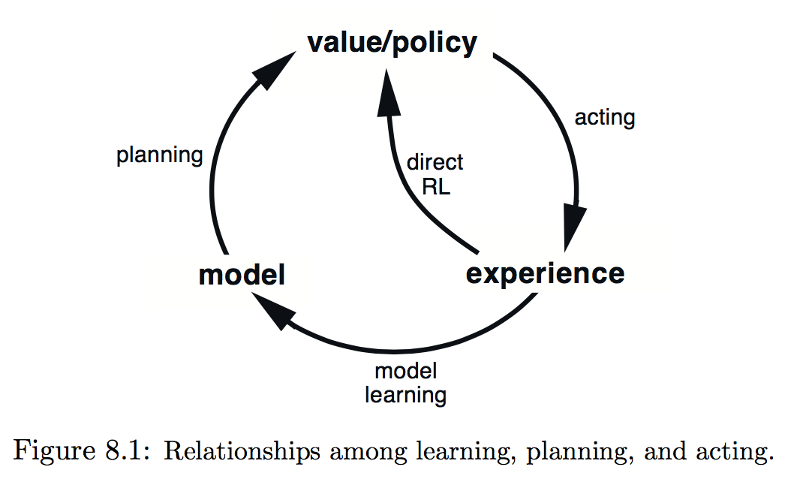
8.2 Dyna: Integrating Planning, Acting, and Learning
Dyna-Q:
Simple architecture integrating planning and learning
Two roles for real experience :
To improve the model (Model-learning / indirect RL)
To directly improve the value function and policy (direct RL)

Slide 9
8.2 Dyna: Integrating Planning, Acting, and Learning
Indirect method:
Make fuller use of a limited experience
Achieve a better policy with fewer environmental interactions.
Direct method:
Much simpler
Not affected by biases in the design of the model.

Slide 10
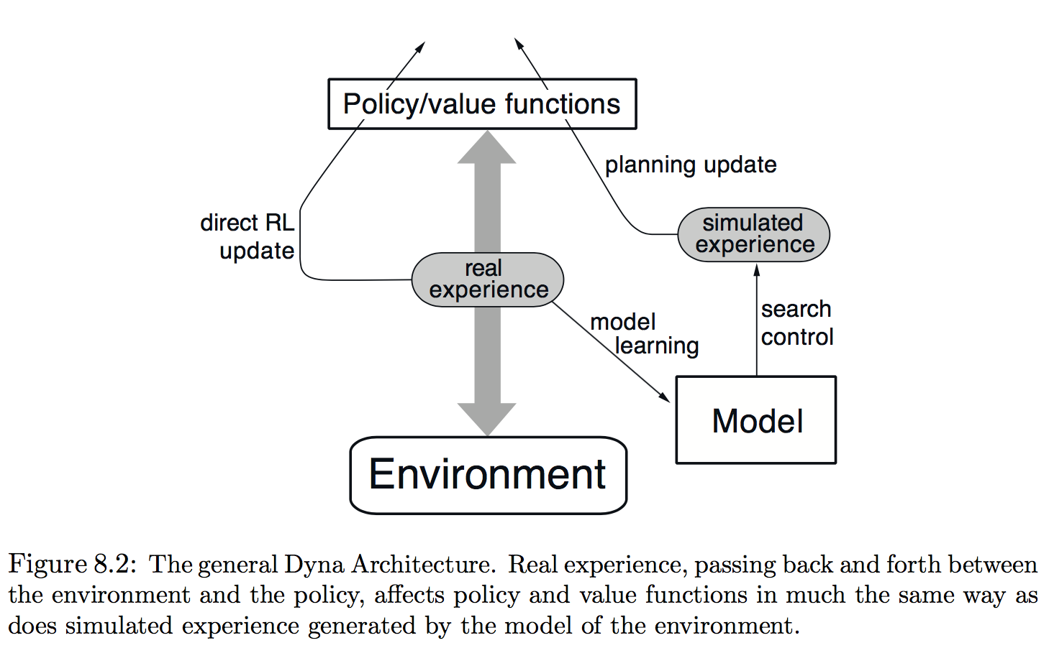
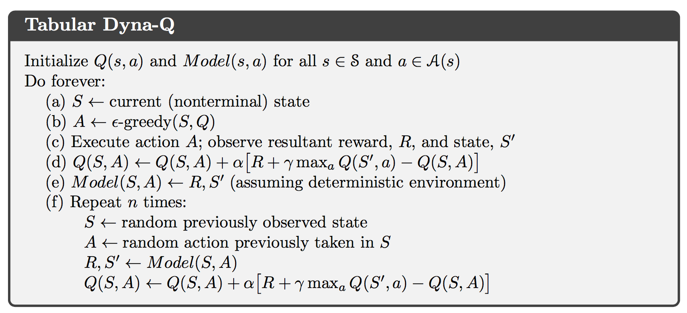
8.2 Dyna: Integrating Planning, Acting, and Learning

Slide 11
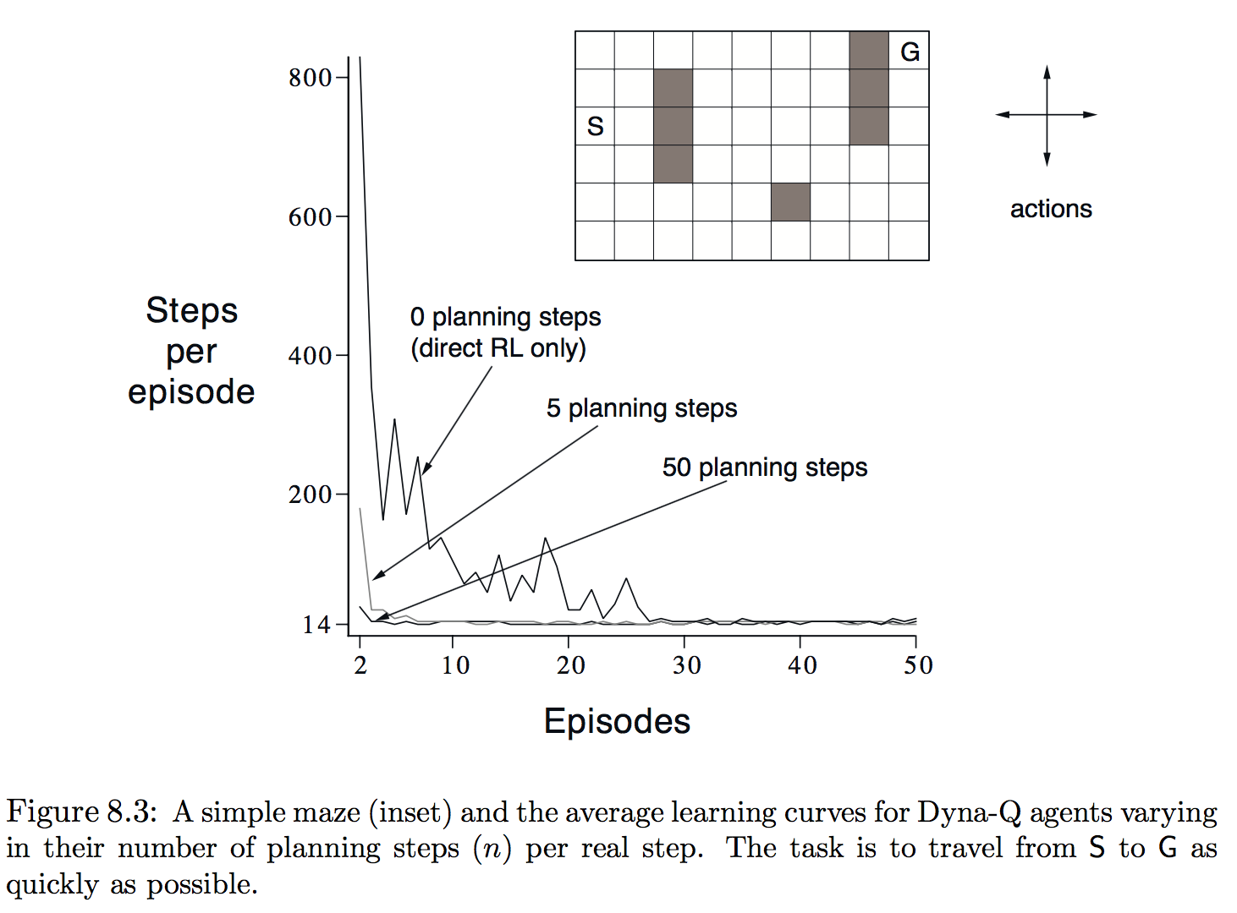
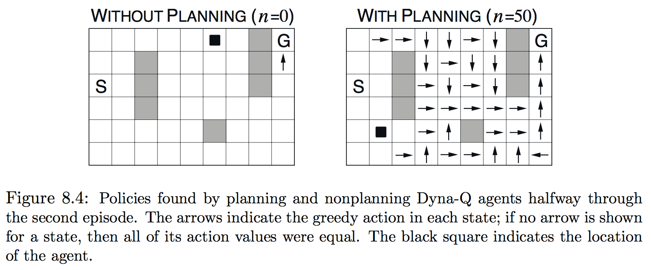
Ex. 8.1: Dyna Maze

Slide 12
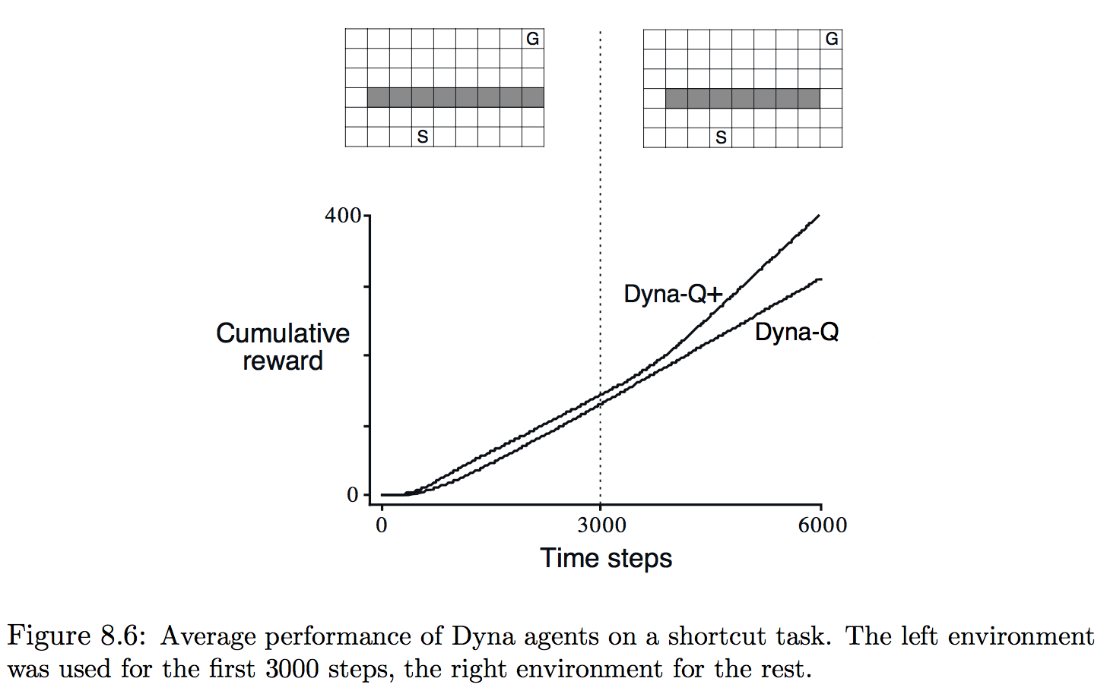
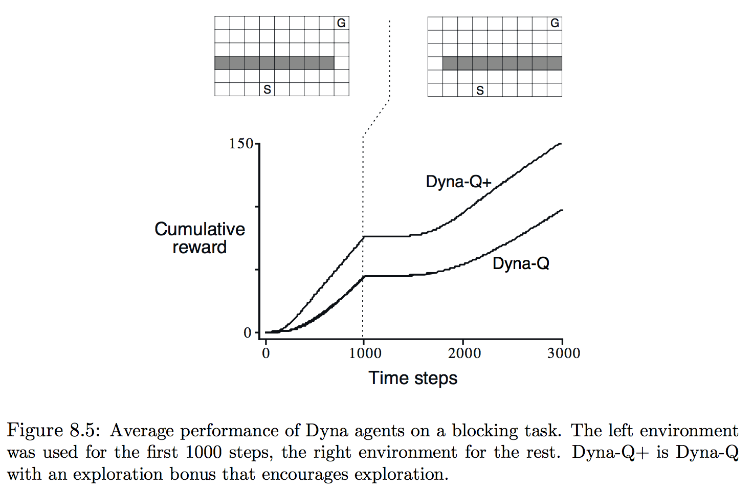
8.3 When the Model is Wrong
Models may be incorrect because the env. is stochastic and only a limited number of samples have been observed.
Or models was learned using function approximation that has generalized imperfectly.
Or simply because the env. Has changed and its new behavior has not yet been observed.
모델이 실제보다 높은 reward나 좋은 state transition을 예측하는 경우에 sub optimal에서 쉽게 빠져나옴.
반대의 경우는 Exploration이 많아야함.

Slide 13
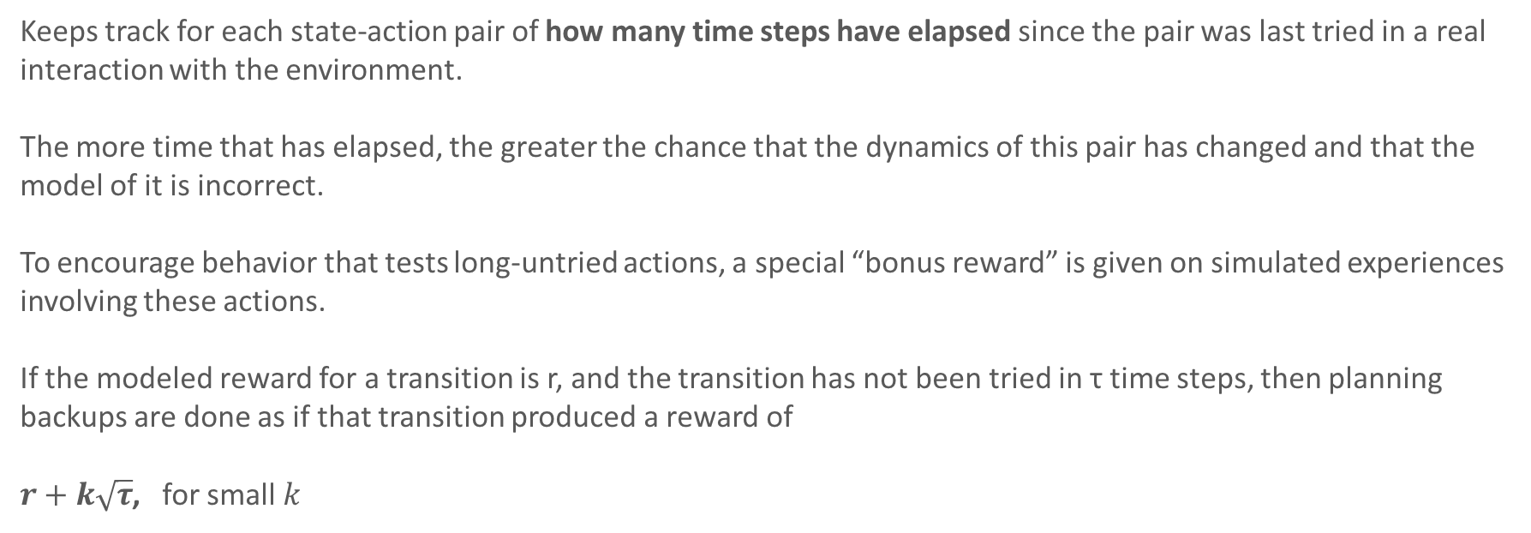
8.3 Dyna Q+
Keeps track for each state-action pair of how many time steps have elapsed since the pair was last tried in a real interaction with the environment.
The more time that has elapsed, the greater the chance that the dynamics of this pair has changed and that the model of it is incorrect.
To encourage behavior that tests long-untried actions, a special “bonus reward” is given on simulated experiences involving these actions.
If the modeled reward for a transition is r, and the transition has not been tried in τ time steps, then planning backups are done as if that transition produced a reward of
$r+k\sqrt{τ}$, for small $k$

Slide 14
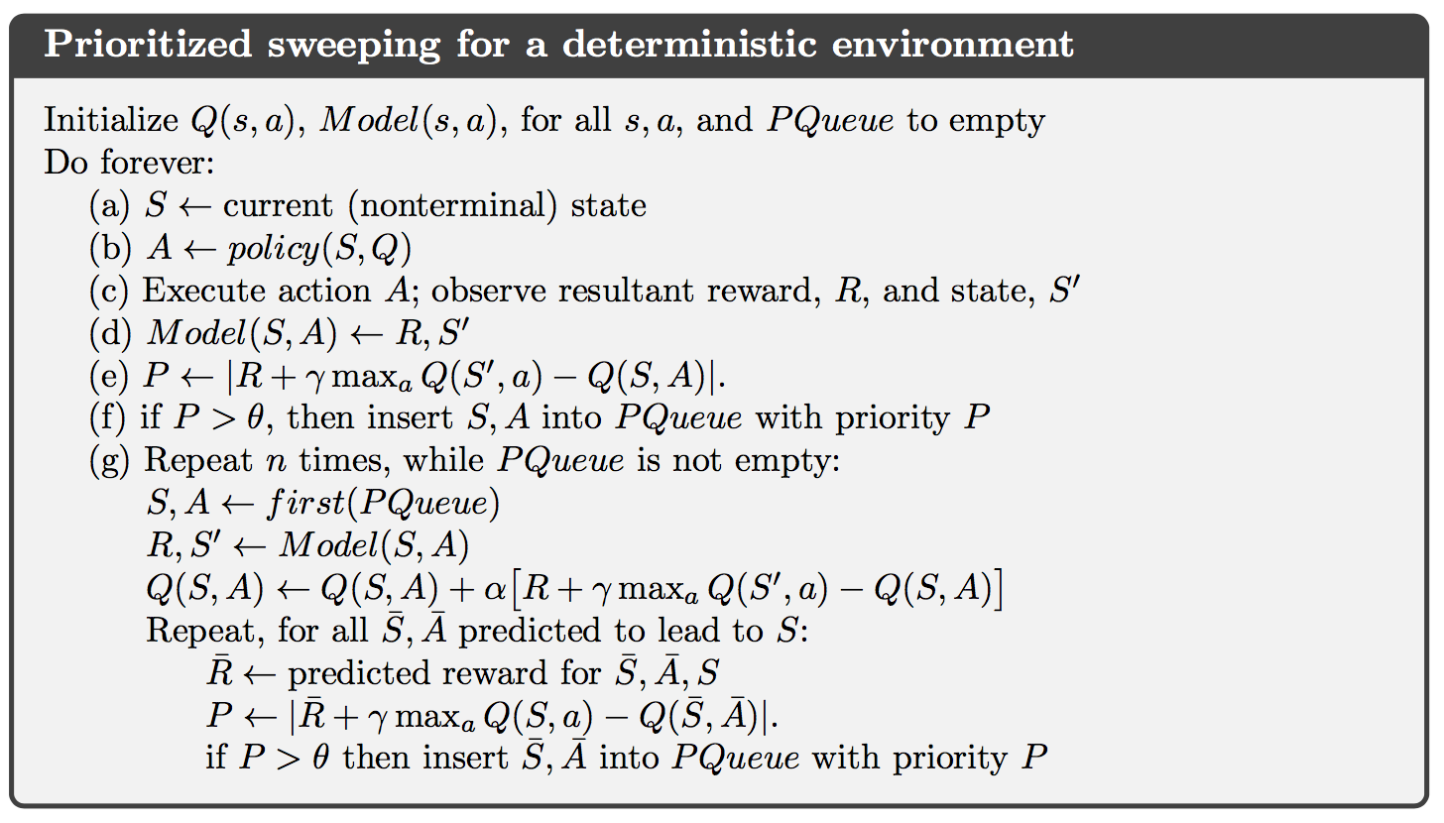
8.4 Prioritized Sweeping
Planning할 때, experience를 랜덤하게 선택(Dyna) 하는게 아니라 우선순위를 두고 선택.
우선순위: 예측한 reward와 실제와의 차이.

Slide 15
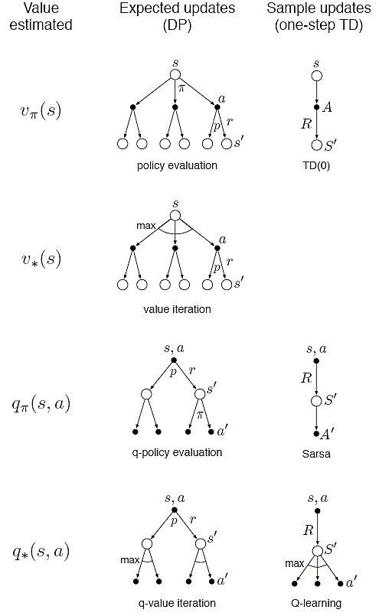
8.5 Expected vs. Sample Updates
Different kinds of value-function updates.
Three dimensions
State values (v) or action values (q)
Value for the optimal policy or for an arbitrary given policy.
Expected updates or sample updates.
Distribution model 이 없으면 Expected update는 불가능하지만
가능한 경우 Expected update가 선호된다.
Sampling error는 없다는 장점이 있지만 많은 computation 필요.
Dyna-Q
Notes:
Previous sections give some idea of combining of Learning and Planning.
In the rest of this chapter, we analyze some of the component ideas involved starting with the relative advantages of expected and sample updates

Slide 16
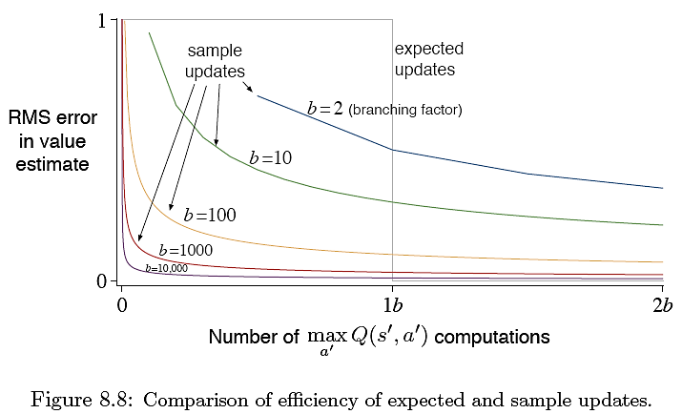
8.5 Expected vs. Sample Updates
Computation 시간이 충분치 않으면 항상 Sample update가 좋다.
- They at least make some improvement in the value estimate with fewer than b (branching factor) updates.
The advantage of sample update is probably an underestimate of the real effect.
In a real problem, the values of the successor states would be estimates that are themselves updated.
By causing estimates to be more accurate sooner, sample updates will have a second advantage in that the values backed up from the successor states will be more accurate.
Notes:
Previous sections give some idea of combining of Learning and Planning.
In the rest of this chapter, we analyze some of the component ideas involved starting with the relative advantages of expected and sample updates

Slide 17
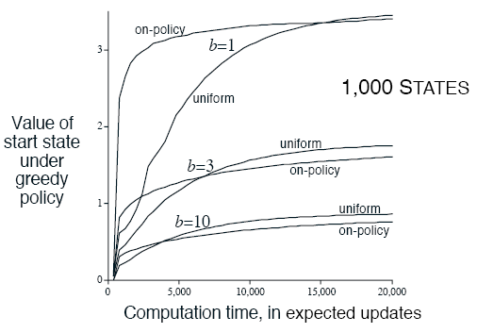
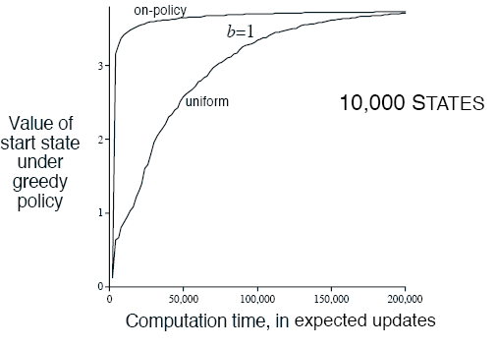
8.6 Trajectory Sampling
Comparing two ways of distributing updates.
Classical approach is to sweeps through entire state space.
Second is to sample from the state or state-action space according to some distribution (on-policy distribution).
One simulates explicit individual trajectories and performs updates at the state or state-action pairs encountered along the way → trajectory sampling
Focusing on the on-policy distribution could be beneficial because it causes vast, uninteresting parts of the space to be ignored, or it could be detrimental because it causes the same old parts of the space to be updated over and over.

Slide 18
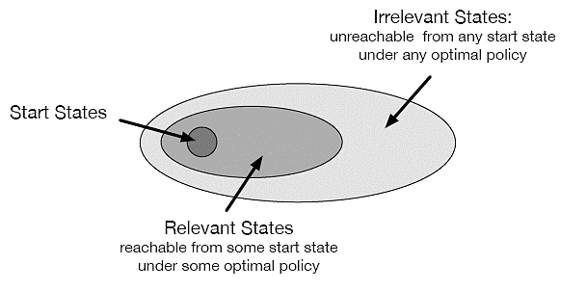
8.7 Real-time Dynamic Programming
RTDP 는 DP의 value-iteration algorithm의 on-policy trajectory-sampling 버전.
(기존 DP의 value-iteration은 sweep based)
주어진 policy로 갈 수 없는 state들은 skip함. → optimal partial policy

Slide 19
8.8 Planning at Decision Time
Planning은 다음 두 가지 방법으로 사용.
Gradually improve a policy or value function
simulated experience 를 이용하여 정책을 개선
Planning is not focused on the current state (background planning)
현재 s의 q값들을 비교하여 a를 선택.
DP, Dyna
Begin and complete it after encountering each new state to decide action.
Simulated experience 를 이용하여 행동 선택
Used when only state values are available
Next state의 Model-predicted value를 비교하여 a를 선택. (select action)
Focuses on a particular state. (decision-time planning)
시간이 충분한 경우에만 사용가능.
Heuristic search, Rollout Algorithm, MCTS

Slide 20
8.9 Heuristic Search
Decision-time planning 의 대표적인 방법
매 state마다 large tree of possible continuation을 고려함.
Leaf 노드에서 v를 approximate한 뒤 current state at the root 로 back up.
현재 state의 v가 계산되면, 최적의 a를 선택하고, 계산 된 v 는 버림.
모델은 완벽한데, action-value function이 불완전 한 경우, deep하게 탐색할 수록 좋은 결과를 내고,
만약 episode 끝까지 탐색하면, 항상 optimal a를 선택할 수 있다.
하지만 computation이 큼.
The most obvious way in which HS focuses updates: on the current state.
모든 computation과 메모리 resource를 현재 event에 집중.

Slide 21
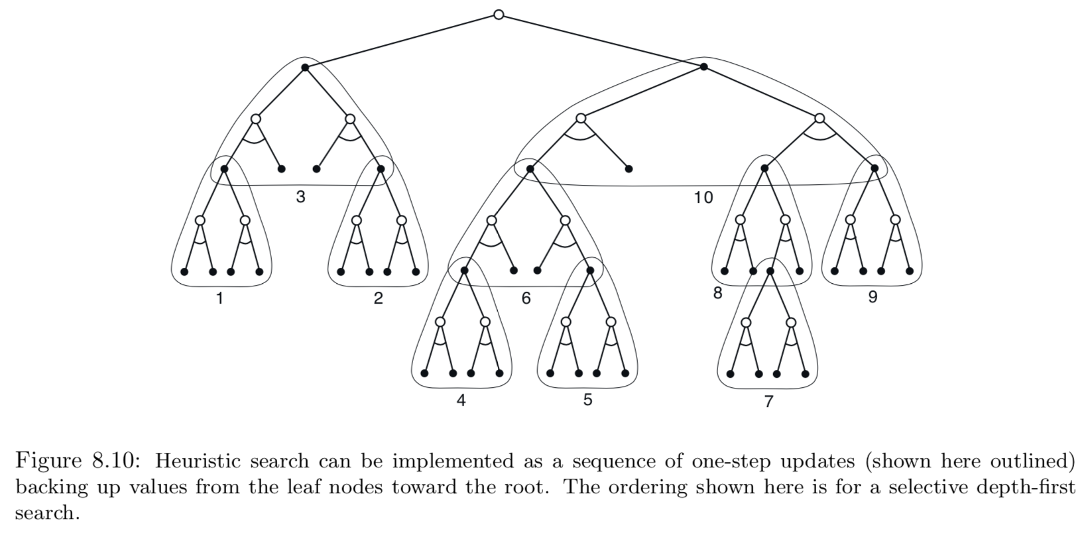
8.9 Heuristic Search
As a limiting case we might use exactly the methods of HS to construct a search tree, and then perform the individual, one-step updates from bottom up.
Deeper search에 의한 성능 개선은 multistep update 때문이아니라, 현재 state에서 downstream state, action update에 집중하기 때문이다.?

Slide 22
8.10 Rollout Algorithms
Simulated trajectories에 Monte Carlo control을 적용한 것을 기반으로 한 Decision-time planning.
많은 simulated trajectories의 return들의 평균으로 q를 계산.
q가 충분히 정확하게 estimate되면, the process is carried out anew from the resulting next state.
The term ‘rollout’ comes from estimating the value of a backgammon position by playing out the position many times to the game’s end with randomly generated sequences of dice rolls, where the moves of both players are made by some fixed policy.
MC control과는 다르게, rollout은 complete optimal q*나 complete q를 estimate 하려는게 아니라
현재 state와 given policy의 MC estimates of action value를 구하려는것.
마찬가지로 쓰고나서 버림.
This makes rollout algorithm relatively simple to implement because there is no need to sample outcomes for every state-action pair, and there is no need to approximate a function over either the state space or the state-action space.
Rollout algorithm의 목표는 optimal policy 를 찾는게 아니라, improve upon the default policy.

Slide 23
8.11 Monte Carlo Tree Search
MCTS is a recent and strikingly successful example of decision-time planning.
At is base, MCTS is rollout algorithm but, enhanced by the addition of a means for accumulating value estimates obtained from the MC simulations in order to successively direct simulations toward more highly-rewarding trajectories.
The core idea is to successively focus multiple simulations starting at the current state by extending the initial portions of trajectories that have received high evaluations from earlier simulations.
It does not have to retain approximate value functions or policies from one action selection to the next, though in many implementations it retains selected action values likely to be useful for its next execution.
For the most part, simulated trajectory에서 a는 간단한 policy에 의해 선택된다. 보통 rollout policy라 부름.
MC value estimates are maintained only for the subset of state-action pairs that are most likely to be reached in a few steps, which form a tree rooted at the current state.

Slide 24
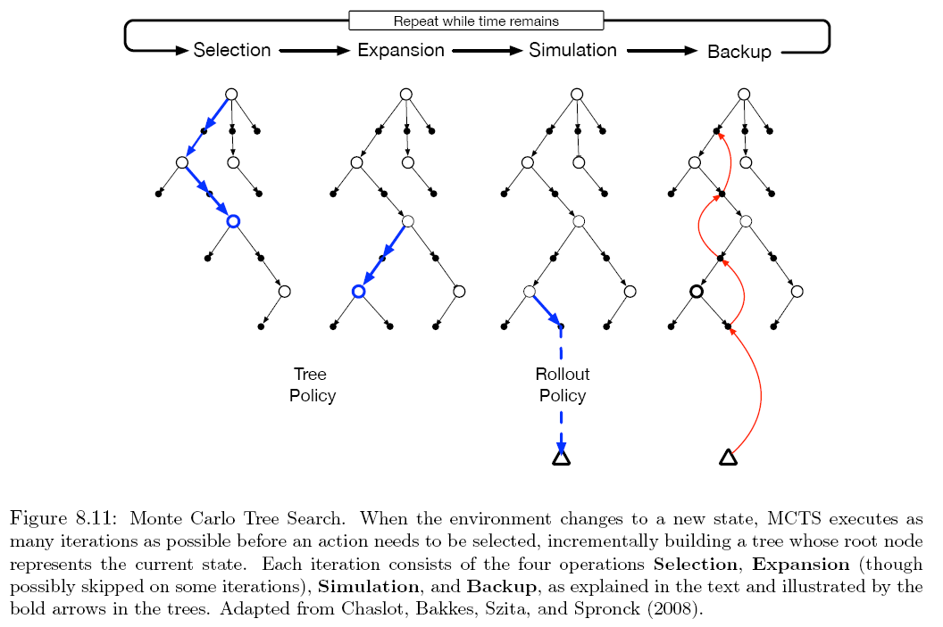
8.11 Monte Carlo Tree Search
Selection. Starting at the root node, a tree policy based on the action values attached to the edges of the tree traverses the tree to select a leaf node.
Expansion. On some iterations, the tree is expanded from the selected leaf node by adding one or more child nodes reached from the selected node via unexplored actions.
Simulation. From the selected node, or from one of its newly-added child node, simulation of a complete episode is run with actions selected by the rollout policy. The result is a MC trial with action selected first by the tree policy and beyond the tree by the rollout policy.
Backup. The return generated by the simulated episode is backed up to update, or to initialize the action values attached to edges. No values are saved for the states and actions visited by the rollout policy beyond the tree.
(e-greedy)

Slide 25
8.11 Monte Carlo Tree Search
루트 노드에서 until no more time is left or computational resource is exhausted 같은 과정을 반복한 뒤 a 선택
MCTS avoid the problem of globally approximating an action-value function while it retains the benefits of using past experience to guide exploration

Slide 27
8.5 Planning as Part of Action Selection
There tends to be two ways of thinking about planning.
Gradual improvement of a policy or value function that is good in all states generally rather than focused on any particular state. (DP and Dyna)
Something begun and completed after encountering each new state S_{t}, as a computation whose output is not really a policy, but rather a single decision, the action A_{t}; on the next step the planning begins anew with S_{t+1} to produce A_{t+1}, and so on.
These two can blend together in natural and interesting ways.
Let us now take a closer look at the second way, at planning as part of action selection.

Slide 28
8.5 Planning as Part of Action Selection
We can still view it as proceeding from simulated experience to backups and values, and ultimately to a policy.
It is just that now the values and policy are specific to the current state and its choices, so much so that they are typically discarded after being used to select the current action.
In many applications this is not a great loss because there are many states and we are unlikely to return to the same state for a long time.
It is most useful in applications in which fast responses are not required.

Slide 29
8.6 Heuristic Search
The classical state-space planning methods in AI are planning-as-part-of-action-selection methods collectively known as heuristic search (HS).
In HS, for each state encountered, a large tree of possible continuations is considered.
The approximate value function is applied to the leaf nodes and then backed up toward the current state at the root.
Once the backed-up values of these nodes are computed, the best of them is chosen as the current action, and then all backed-up values are discarded.
In fact, the value function is generally designed by people and never changed as a result of search.
However, it is natural to consider allowing the value function to be improved over time, using either the backed-up values computed during HS or any of the other methods presented throughout this book.

Slide 30
8.6 Heuristic Search
Greedy and e-greedy action-selection methods are not unlike HS.
For example, to compute the greedy action given a model and a state-value functions, we must look ahead from each possible action to each possible next state, backup the rewards and estimated values, and then pick the best action.
Just as in HS, this process computes backed-up values of the possible actions, but does not attempt to save them.
Thus, HS can be viewed as an extension of the idea of a greedy policy beyond a single step.

Slide 31
8.6 Heuristic Search
Much of the effectiveness of HS is due to its search tree being tightly focused on the states and actions that might immediately follow the current state.
In chess, there are far too many possible positions to store distinct value estimates for each of them, but chess programs based on HS can easily store distinct estimates for the millions of positions they encounter looking ahead from a single position.
This great focusing of memory and computational resources on the current decision is presumably the reason why HS can be so effective.

Slide 32
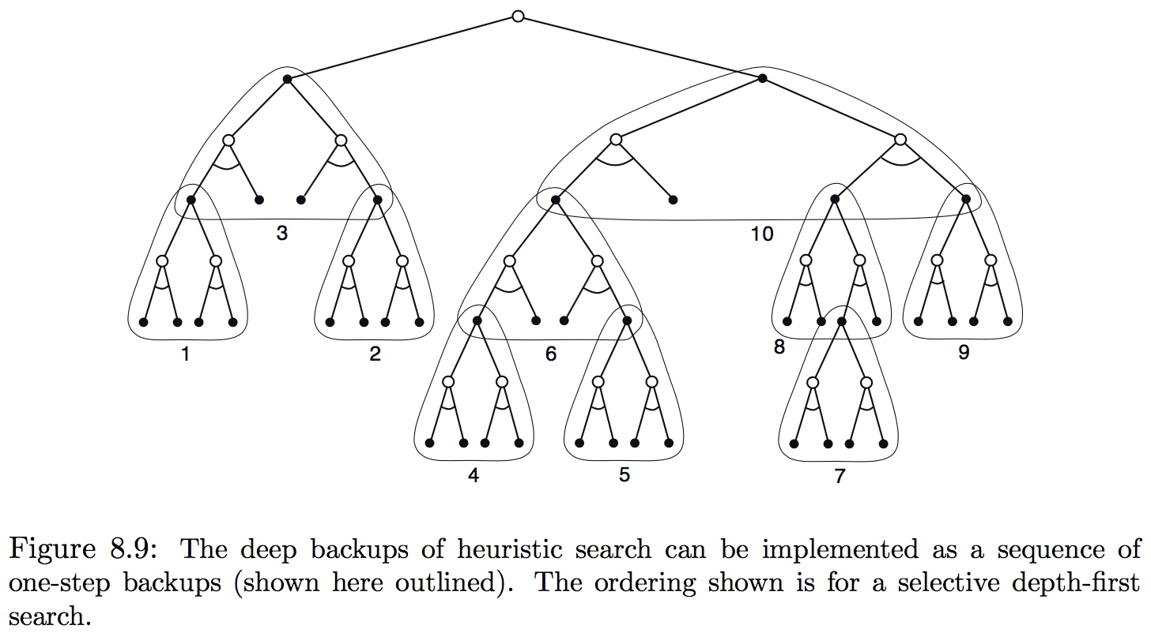
8.6 Heuristic Search
As a limiting case we might use exactly the methods of HS to construct a search tree, and then perform the individual, one-step backups from bottom up as figure below.
If the backups are ordered in this way and a table-lookup representation is used, then exactly the same backup would be achieved as in depth-first heuristic search.
Any state-space search can be viewed in this way as the piecing together of a large number of individual one-step backups.
Thus, the performance improvement observed with deeper searches is not due to the use of multistep backups as such. Instead, it is due to the focus and concentration of back-ups on states and actions immediately downstream from the current state.

Slide 33
8.7 Monte Carlo Tree Search
Monte Carlo Tree Search (MCTC) is one of the simplest examples of
planning as part of the policy.
It is effective in a wide variety of competitive settings, including general game playing.
It is most often used when the model of the world is completely known and cheap to compute, as it is in many games.
MCTS typically involves no approximate value functions or policies that are retained from one time step to the next; these are computed on each step and then discarded.
The actions in the simulated trajectories are generated using a default policy (often just equi-probable random policy).
The value of a state-action pair is estimated as the average of the returns from that pair.

Slide 34
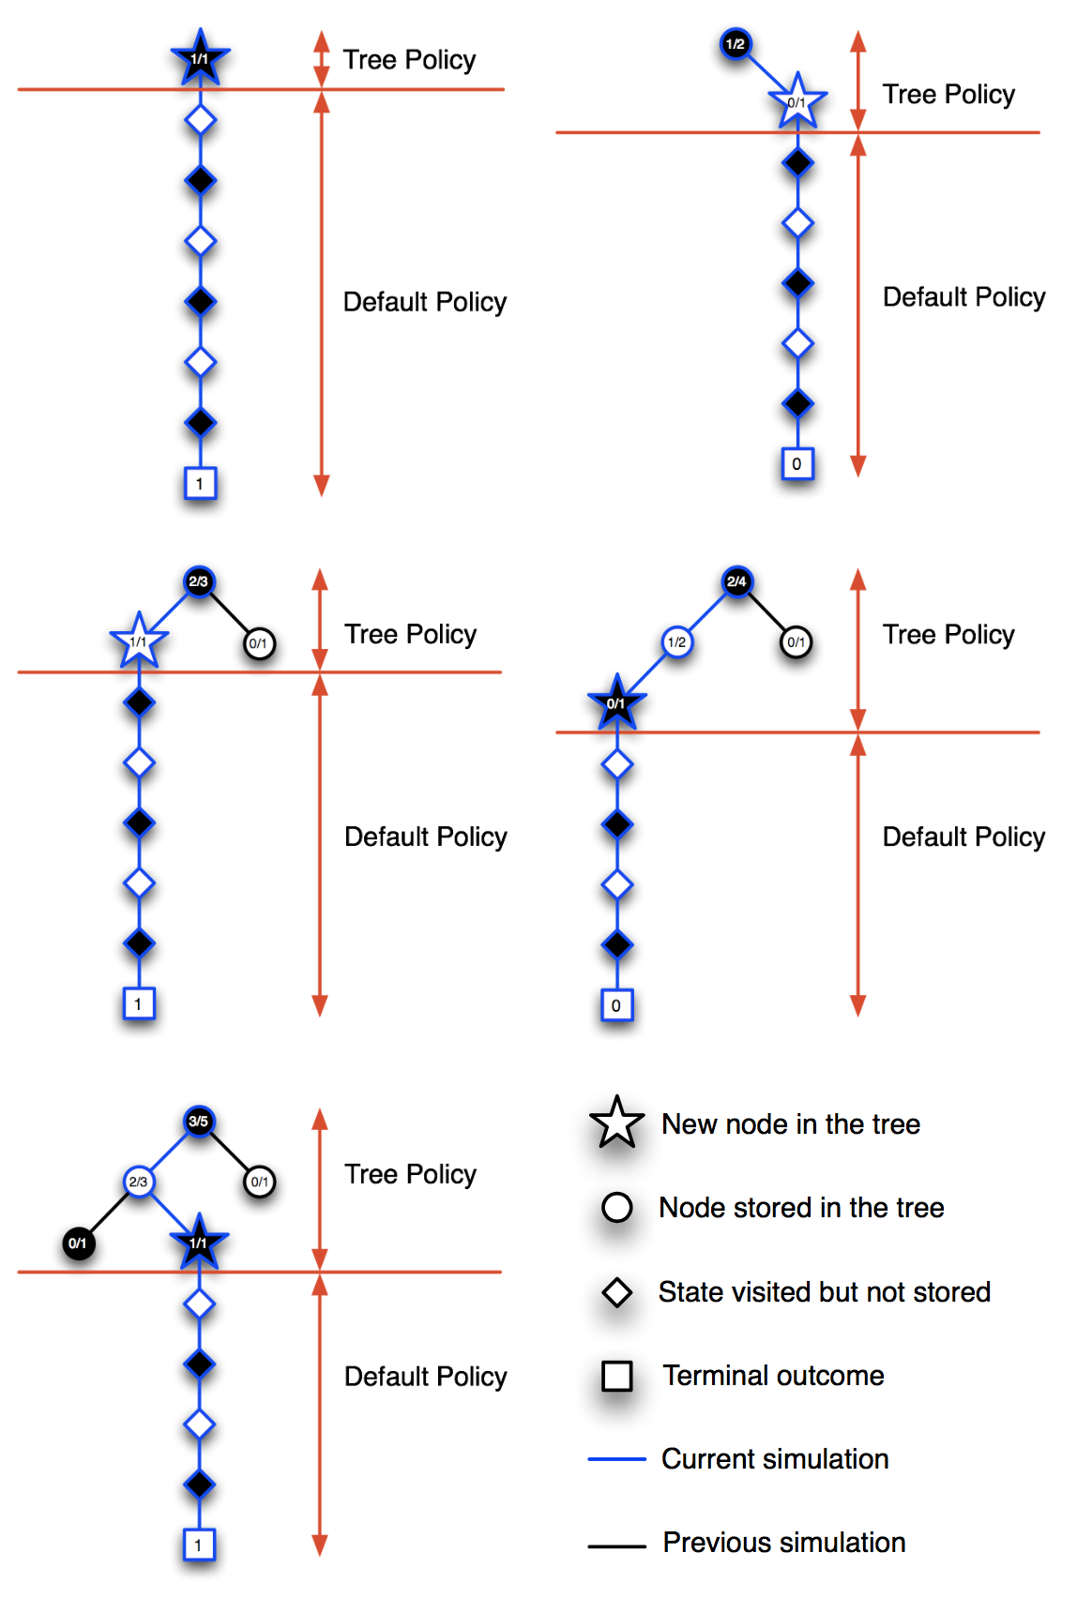
8.7 Monte Carlo Tree Search
At state on the fringe of the tree there will be actions with zero previous trajectories; these can be considered of infinite value so that one of them is selected, after which it is added to the tree.
The initial tree consists of just the current state.

Slide 35
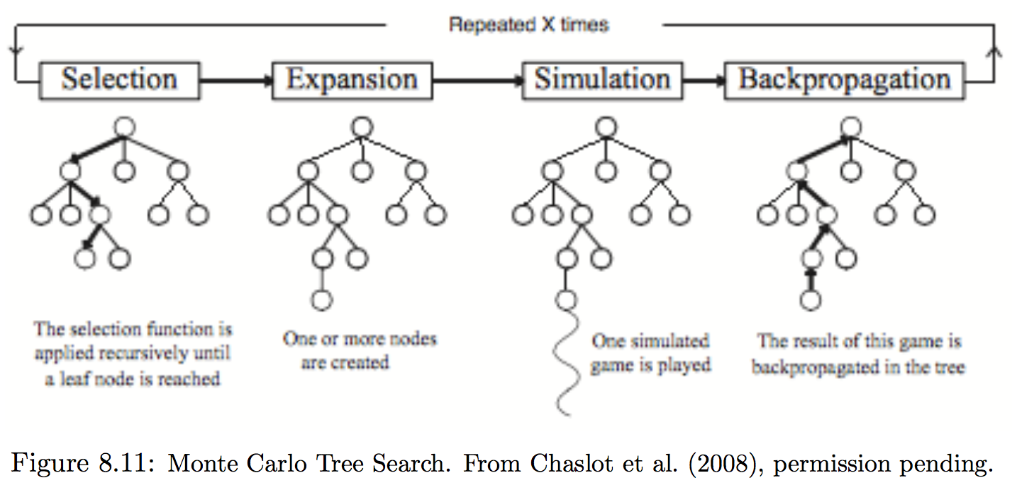
8.7 Monte Carlo Tree Search
MCTS incrementally builds a partial game tree to select each of a game-playing program’s moves.
Each game tree node represents a game state, and each edge linking a node representing a state s to a child node representing a state s’ corresponds to a state-action pair (s,a) where s’ is successor state under actions a.
At the start of MCTS, the current game state is the root node of the partial game tree.
Each iteration of MCTS proceeds in four states

Slide 36
8.7 Monte Carlo Tree Search
Selection: a node in the current tree is selected by some informed means as the most promising node from which to explore further
Expansion: the tree is expanded from the selected node by adding one or more nodes as its children. Each new child node is now a leaf node of the partial game tree, meaning that none of its possible moves have been visited yet in constructing the tree.
Simulation: again directed by an informed means, one of these leaf nodes, or another node having an unvisited move, is selected as the start of a simulation, or rollout, of a complete game in which moves are selected by a rollout policy.
Backpropagation: the result of the simulated game is backed up to update, or to initialize, statistics attached to the links in the partial game tree traversed in this MCTS iteration No statistics are maintained for the links corresponding to states outside of the partial game tree that are visited in the simulation.

Slide 37
8.7 Monte Carlo Tree Search
MCTS continues this process until no more time is left, or some other computational resource is exhausted.
Then, finally, a move from the root node is selected according to some mechanism that depends on the accumulated statistics in the partial game tree.
After the opponent’s move, MCTS is run again with new state and containing any descendants of this node from previous play.
The remaining nodes are discarded.

